Slide 1
Chapter 12 International Business: Opportunities and Challenges in a Flattening World
Chapter 12 Winning through Effective, Global Talent Management

Slide 2
HR as a Strategic Partner
The role of human resources management (HRM) is changing in business, particularly in international business.
Previously considered a support function, HRM is now becoming a strategic partner in helping a global company achieve its goals.
The strategic approach to HRM—strategic human resources management (SHRM)—means going beyond administrative tasks such as payroll processing.
Instead, managers need to think more broadly and deeply about how employees will contribute to the company’s success.

Slide 3
The following are some questions that HRM should be prepared to answer in this new world
Competence. To what extent does our company have the required knowledge, skills, and abilities to implement its strategy?
Consequence. To what extent does our company have the right measures, rewards, and incentives in place to align people’s efforts with the company strategy?
Governance. To what extent does our company have the right structures, communications systems, and policies to create a high-performing organization?
Learning and Leadership. To what extent can our company respond to uncertainty and learn and adapt to change quickly?

Slide 4
The Importance of Human Capital
Employees provide an organization’s human capital.
Your human capital is the set of skills that you have acquired on the job—through training and experience—which increase your value in the marketplace.
Definition of an organization’s human capital : “the collective sum of the attributes, life experience, knowledge, inventiveness, energy, and enthusiasm that its people choose to invest in their work

Slide 5
Key Elements of HRM
Selection and Placement
Job Design
Compensation and Rewards
Diversity Management

Slide 6
Selection and Placement
nature of the jobs expected to fulfill early in the hiring process includes :
explaining the technical competencies needed (e.g., collecting statistical data) and defining behavioral competencies.
Behavioral competencies may have a customer focus, such as the ability to show empathy and support of customers’ feelings and points of view, or a work-management focus, such as the ability to complete tasks efficiently or to know when to seek guidance.
In addition, an SHRM best practice is to make the organization’s culture clear by discussing the values that underpin the organization

Slide 7
Job Design
Job design refers to the process of combining tasks to form a whole job.
The goal is to design jobs that involve doing a whole piece of work and that are challenging but ultimately doable for the employee.
Job design also takes into account issues of health and safety of the worker.
When planning jobs or assigning people to jobs, HR managers also consider training (ensuring that employees to have the knowledge and skills to perform all parts of their job) and giving them the authority and accountability to do so

Slide 8
Compensation and Rewards
The SHRM function also includes evaluating and paying people on the basis of their performance—not simply for showing up to the job.
Firms must offer rewards for skill development and organizational performance, emphasizing teamwork, collaboration, and responsibility for performance.
Good compensation systems include incentives, gainsharing, profit sharing, and skill-based pay that rewards employees who learn new skills and put those skills to work for the organization.
Employees who are trained in problem solving and a broad range of skills are more likely to grow on the job and feel more satisfaction.
Their training enables them to make more valuable contributions to the company, which, in turn, gains them higher rewards and greater commitment to the company

Slide 9
Diversity Management
Another key to successful SHRM in today’s business environment is embracing diversity.
In past decades, “diversity” meant avoiding discrimination against women and minorities in hiring.
Today, diversity goes far beyond this limited definition; diversity management involves actively appreciating and using the differing perspectives and ideas that individuals bring to the workplace.
Diversity is an invaluable contributor to innovation and problem-solving success.

Slide 10
Diversity Management
Diversity helps company teams to come up with more creative and effective solutions.
Teams whose members have complementary skills are often more successful because members can see one another’s blind spots.
Diverse people will probably make different kinds of errors, which also means that they’ll be more likely to catch and correct each other’s mistakes.

Slide 11
What Employees Want
Employees want to grow and develop, stretching their capabilities.
They want projects that engage their heads as well as their hearts,
and they want to connect with the people and things that will help them achieve their professional goals

Slide 12
What Employees Want
two ways to provide this to your employees: First, connect people with mentors and help them build their networks.
Research suggests that successful managers dedicate 70 percent more time to networking activities and 10 percent more time to communication than their less successful counterparts

Slide 13
What makes networks special?
Through networks, people energize one another as well as learn, create, and find new opportunities for growth.
Second, help connect people with a sense of purpose.
Focusing on the need for purpose is especially important for younger workers, who rank meaningful work and challenging experiences at the top of their job-search lists.

Slide 14
Benefits of Good Talent Management
The survey results, reported in May 2008, show that there was indeed a relationship between a firm’s financial performance and its global talent-management practices.
Three talent-management practices, in particular, correlated highly with exceptional financial performance:
Creating globally consistent talent-evaluation processes
Achieving cultural diversity in a global setting
Developing and managing global leaders

Slide 15
Benefits of Good Talent Management
The coming shortage of workers makes it imperative for managers to find, hire, retain, and develop their employees.
Managers first need to define the skills that the company will need for the future.
Then they can “make or buy”—that is, train or hire—employees with the needed skills.
Retaining these employees requires engaging them on the job.
Good talent-management practices translate into improved financial performance for the company as a whole.

Slide 16
Effective Selection and Placement Strategies
Effective selection and placement means finding and hiring the right employees for your organization and then putting them into the jobs for which they are best suited.
Providing an accurate and complete job description is a key step in the selection process.
An important determination is whether the candidate’s personality is a good fit for the company’s culture.
Interviewing is a common selection method.
Situational interviews ask candidates to describe how they handled specific situations in the past (experience-based situational interviews)
and how they would handle hypothetical questions in the future (future-oriented situational interviews).

Slide 17
Effective Selection and Placement Strategies
Other selection tools include cognitive tests, personality inventories, and behavioral-traits assessments.
Specific personalities may be best suited for positions that require sales, teamwork, or entrepreneurship, respectively.
In our increasingly global economy, managers need to decide between using expatriates and hiring locals when staffing international locations

Slide 18
The Roles of Pay Structure and Pay for Performance
Compensation plans reward employees for contributing to company goals.
Pay levels should reflect the value of each type of job to the company’s overall success.
For some companies, technical jobs are the most vital, whereas for others frontline customer-service positions determine the success of the company against its competitors.

Slide 19
The Roles of Pay Structure and Pay for Performance
Companies should identify the types of teams they have—parallel, work, project, or partnership—and then choose the pay options that are most appropriate.
Pay-for-performance plans tie an individual’s pay directly to their ability to meet performance targets.
These plans can reward individual performance or team performance—or a combination of the two.

Slide 20
Tying It All Together—Using the HRM Balanced Scorecard to Gauge and Manage Human Capital, Including Your Own
Workforce mind-set and culture. Does the workforce understand the strategy and embrace it? Does the workforce have the culture needed to support strategy execution?
Workforce competencies. Does the workforce, especially in the strategically important or “A” positions, have the skills it needs to execute the strategy? (Remember that “A” positions are those job categories most vital to the company’s success.)

Slide 21
Tying It All Together—Using the HRM Balanced Scorecard to Gauge and Manage Human Capital, Including Your Own
Leadership and workforce behaviors. Are the leadership team and workforce consistently behaving in ways that will lead to the attainment of the company’s key strategic objectives?
Workforce success. Has the workforce achieved the key strategic objectives for the business?
(If the organization can answer yes to the first three elements, then the answer should be yes here as well.)

Slide 22
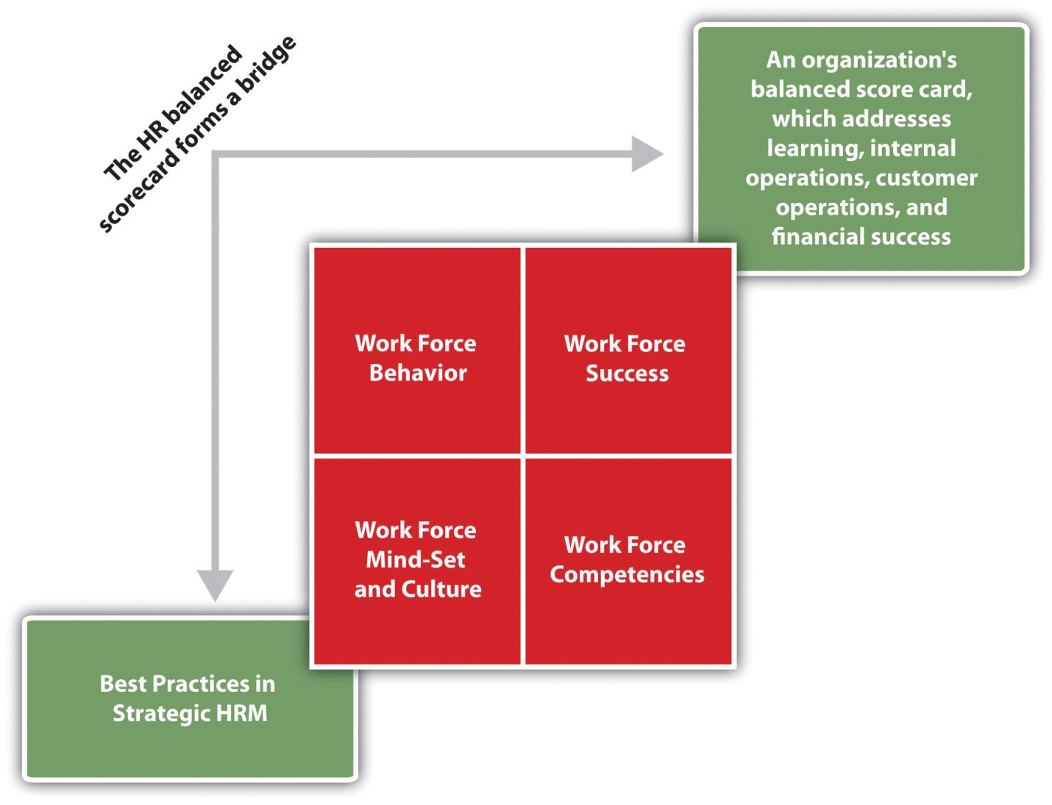
as summarized in the following figure, the Workforce Scorecard has four key sequential elements

Slide 23
The Balanced Scorecard, when applied to HRM, helps managers align all HRM activities with the company’s strategic goals.
Assigning metrics to the HRM activities lets managers track progress on goals and ensure that they’re working toward strategic objectives.
It adds rigor and lets managers quickly identify gaps.

Slide 24
Companies that measure intangibles such as employee performance, innovation, and change perform better financially than companies that don’t use such metrics.
Rather than investing equally in training for all jobs, a company should invest disproportionately more in developing the people in the key strategic (“A”) jobs on which the company’s success is most dependent.

